Slide 2
DF TICKETING SYSTEM https://dfticketing.org

Slide 3
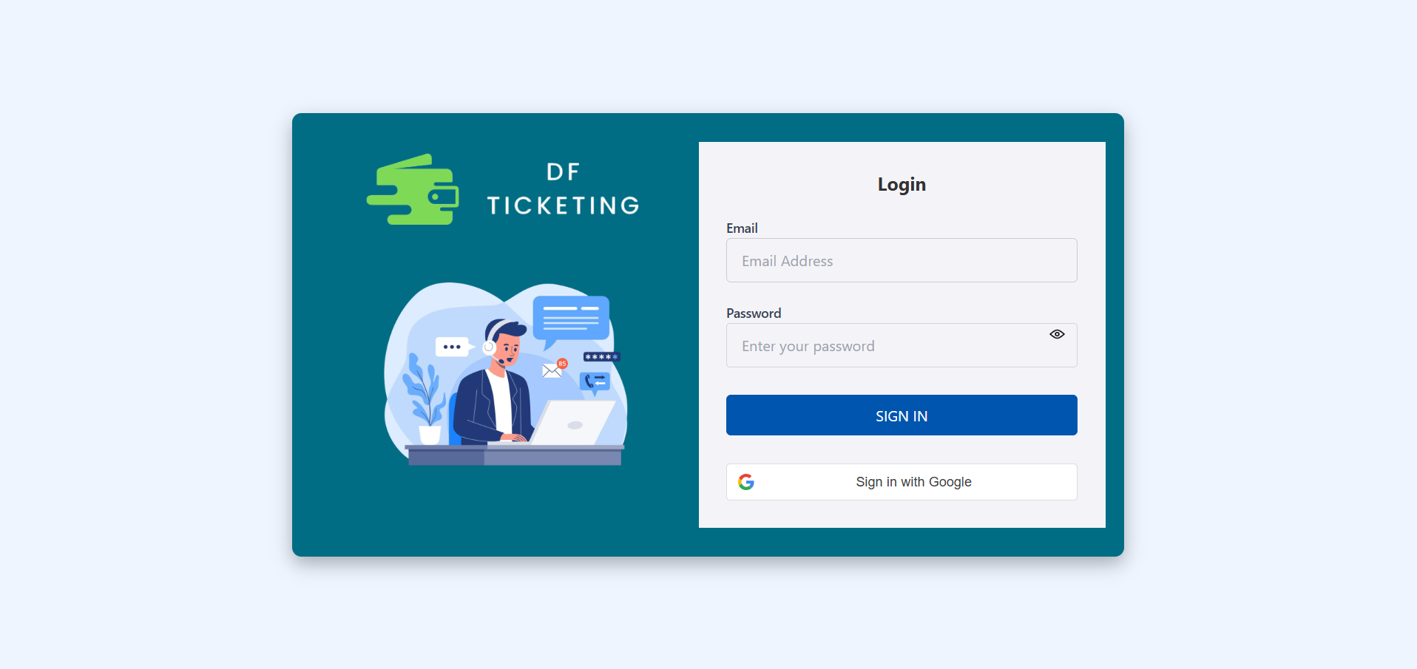
Login Page
You can log in using your DF email and the auto-generated password sent to your registered email address.
OR
You can log in using the Google option with your registered DF email address.

Slide 4
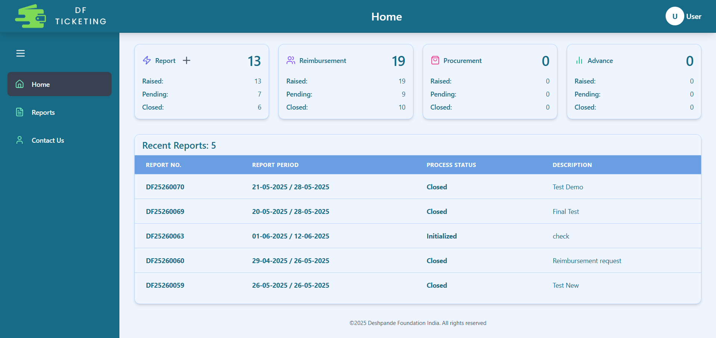
Home Page
This is the Profile section
Click the plus (+) button to create a new report.
At the top, you can view the number and status of Reports you have opened, as well as those related to Reimbursement, Procurement, and Advance.
In this section, you can view the Report Details, including the Report Number, Report Period, Process Status, and Report Description.

Slide 5
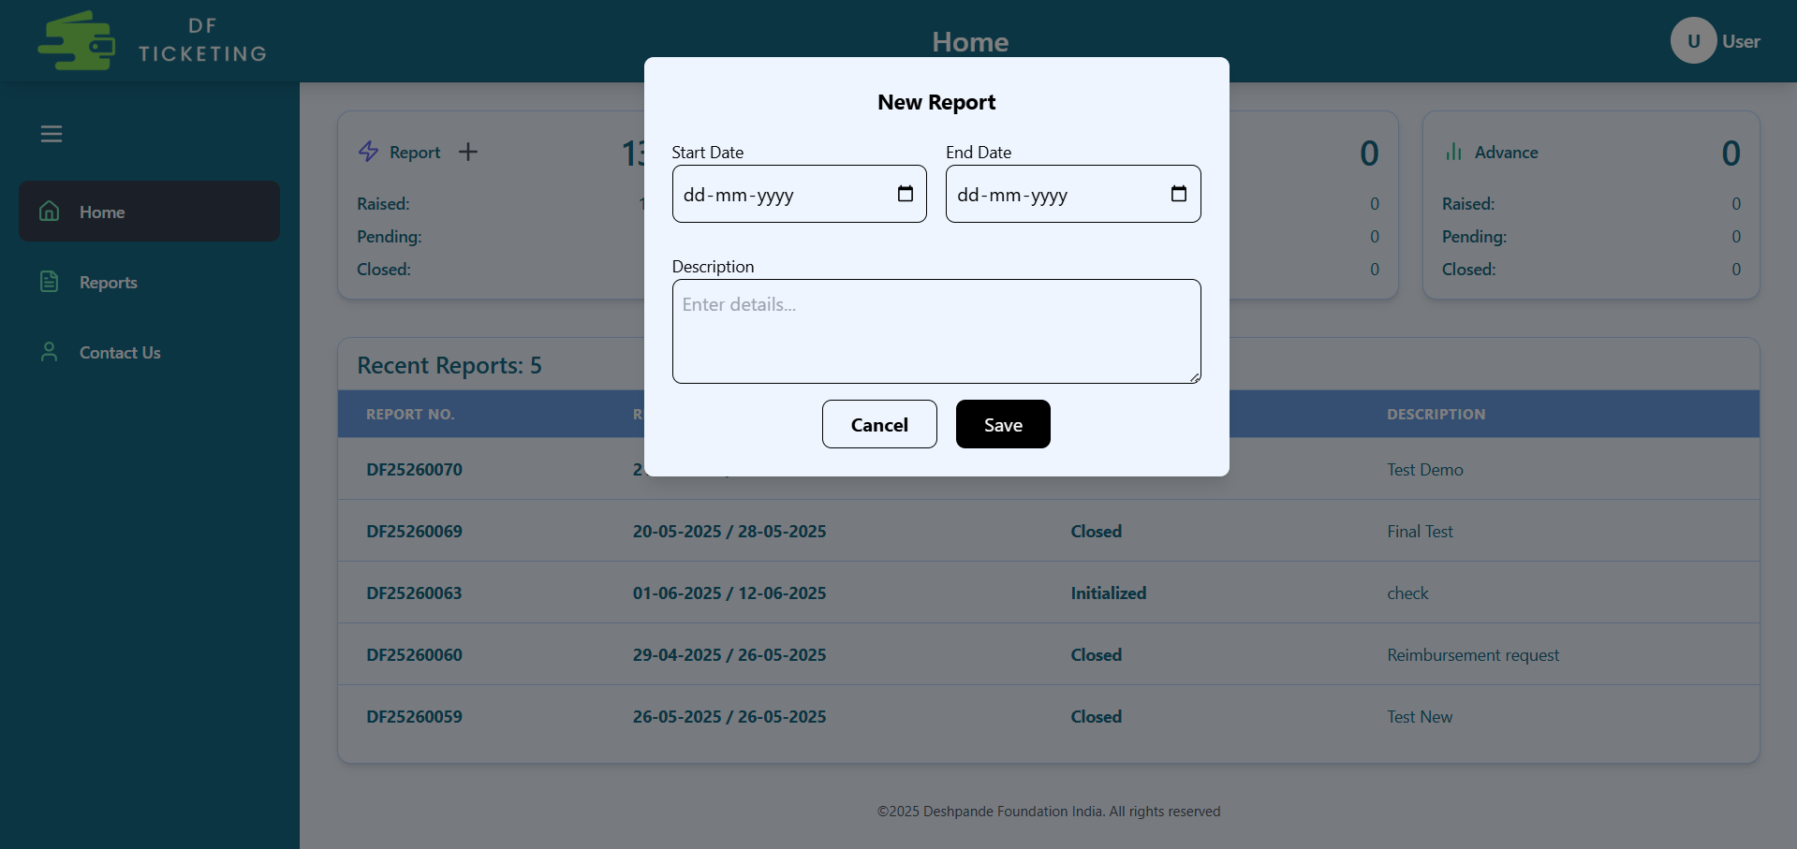
Create NEW Report
These dates define the time range for the tickets you intend to create.
When you click the plus (+) button, this pop-up will appear. You need to fill in all the details, including the Report Start Date, Report End Date, and a short description of the report.
Click on 'Save' to create the report.

Slide 6
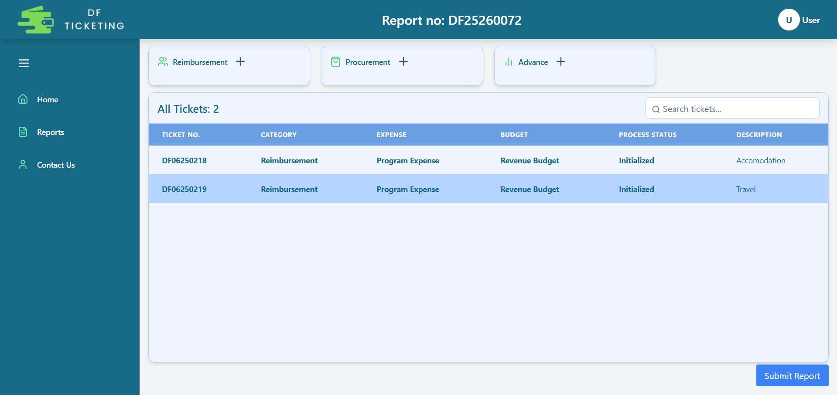
Tickets Section
This is the Report ID
From here, you can create different types of tickets such as Reimbursement, Procurement, and Advance.
Here, you can view the tickets you have created.
This is Ticket ID
Click 'Submit' to submit your report along with all your tickets.

Slide 7
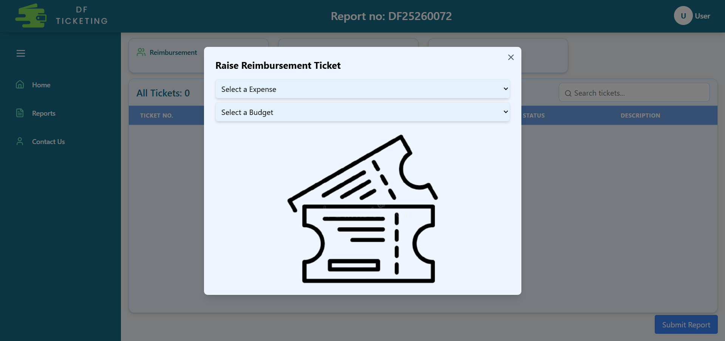
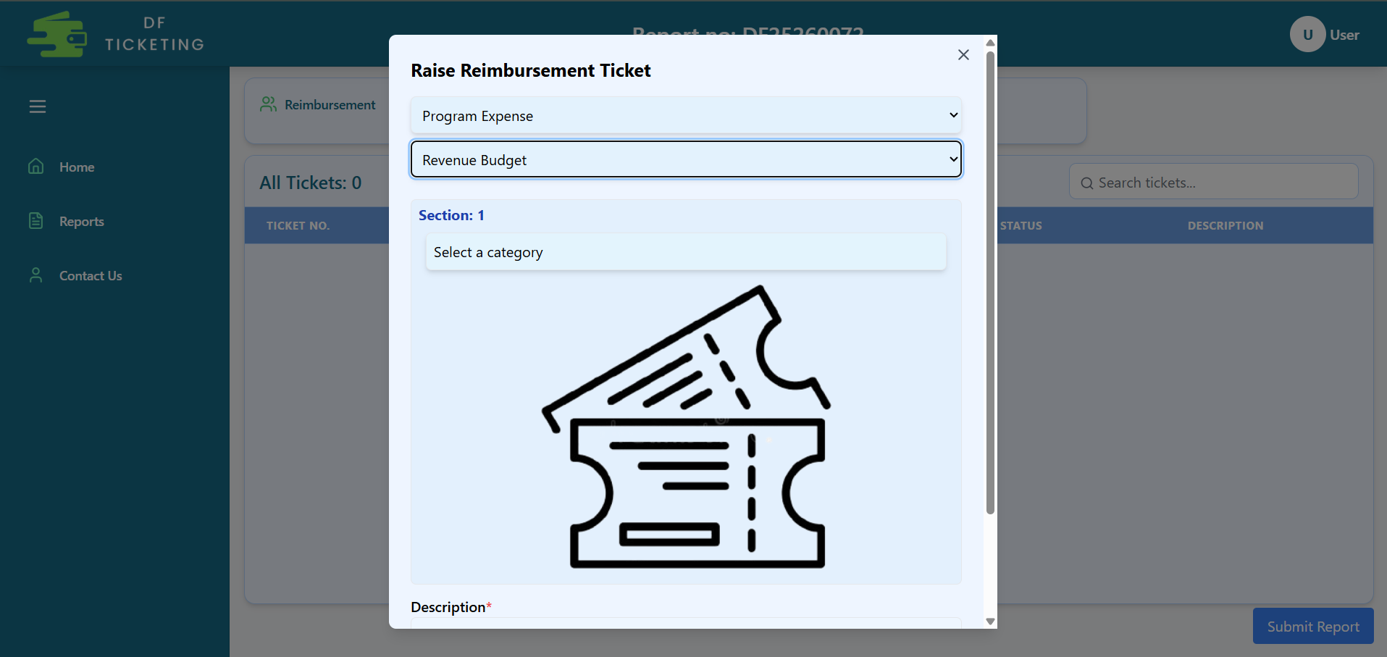
Create Reimbursement Ticket
When you click the plus (+) button next to Reimbursement, a pop-up will open where you need to select the Expense Type and Budget Type.
As you make your selection, the section below will open, allowing you to choose the reimbursement category—such as Food, Travel, Accommodation, etc.

Slide 8
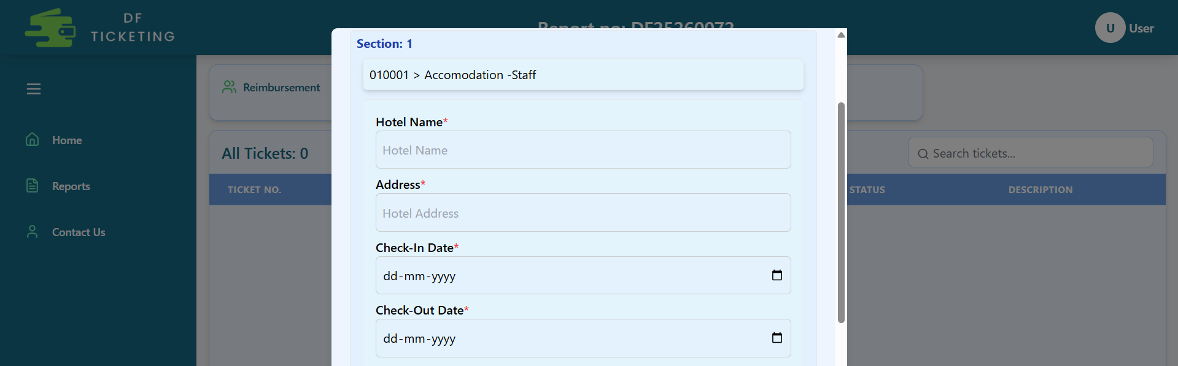
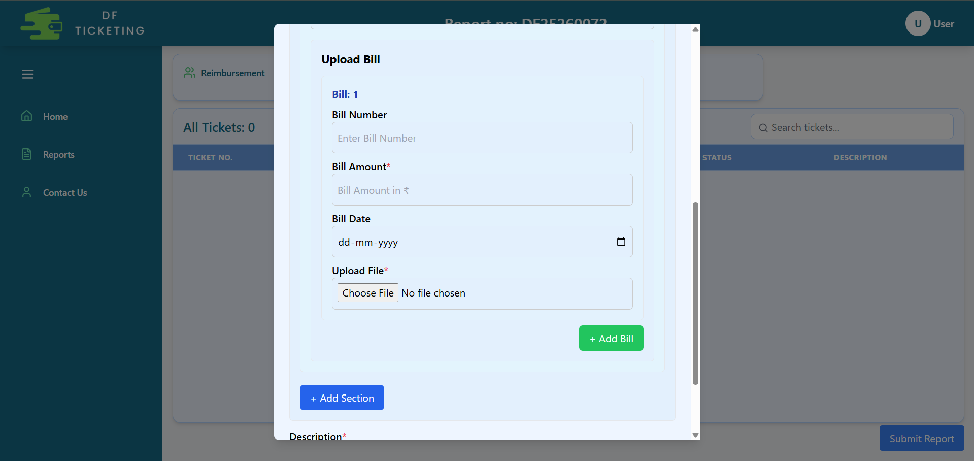
Accommodation Reimbursement
Now, if you select Accommodation, this section will open where you need to fill in all the details marked with a red asterisk (*).
The section below is for attaching bills related to that expense.

Slide 9
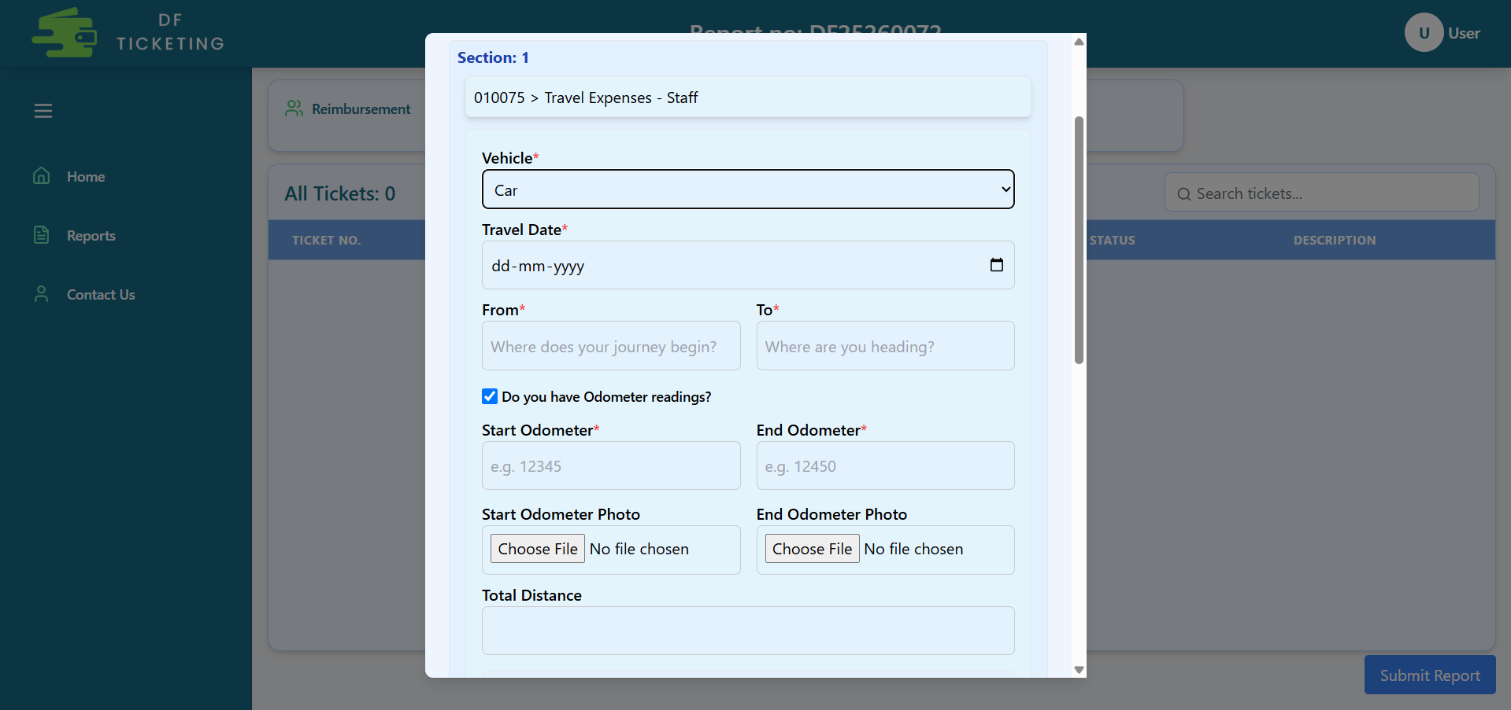
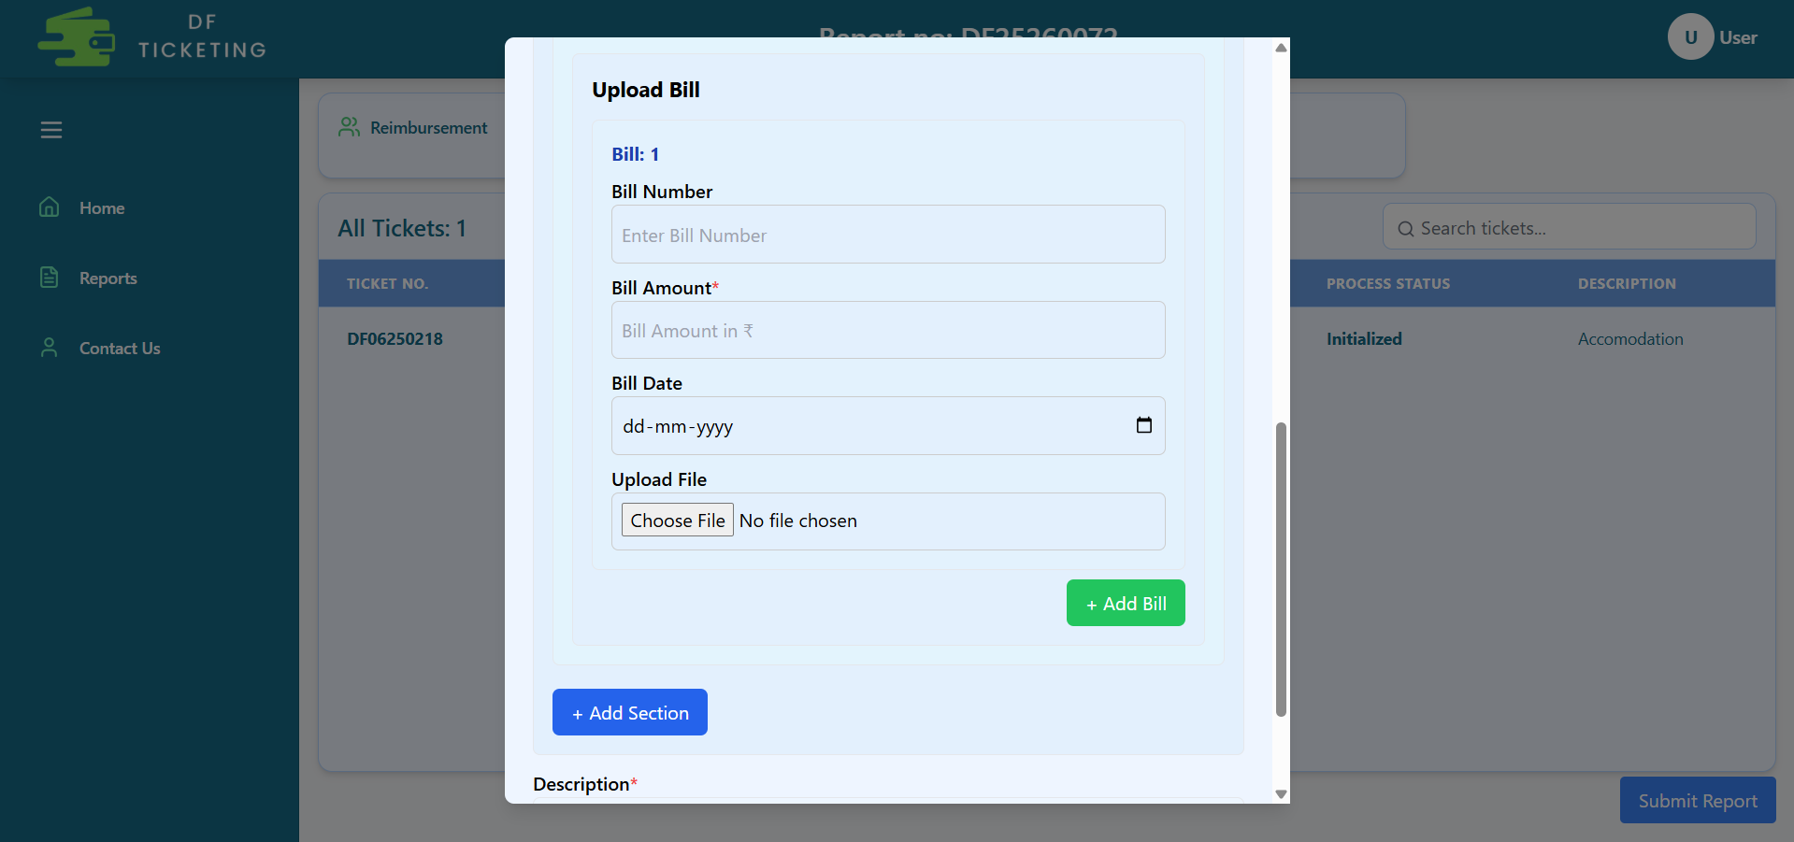
Travel Reimbursement
Now, if you select Travel, this section will open where you need to fill in all the details marked with a red asterisk (*).
The section below is for attaching bills related to that expense.

Slide 10
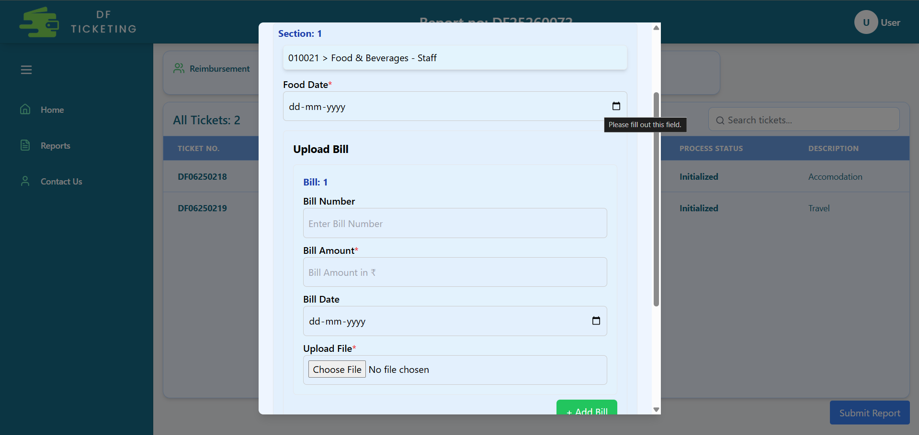
Food Reimbursement
Now, if you select Food, this section will open where you need to fill in all the details marked with a red asterisk (*).
The section below is for attaching bills related to that expense.

Slide 11
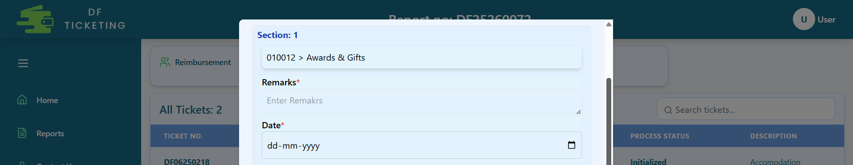
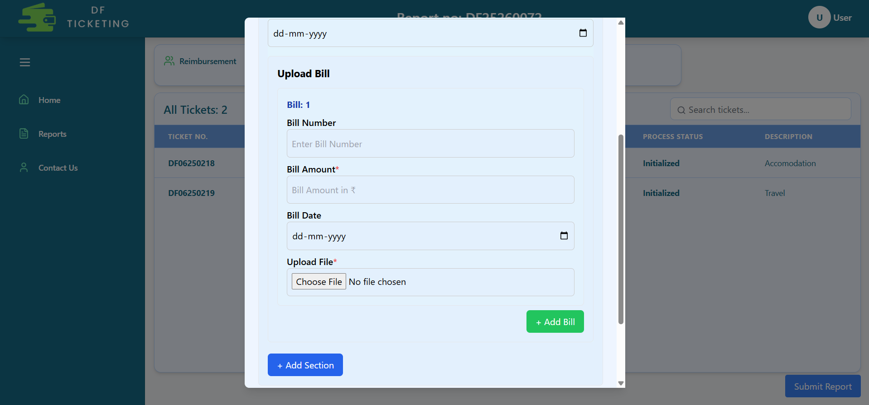
Any Other Reimbursement
Now, if you select Other Reimbursement, this section will open where you need to fill in all the details marked with a red asterisk (*).
The section below is for attaching bills related to that expense.

Slide 12
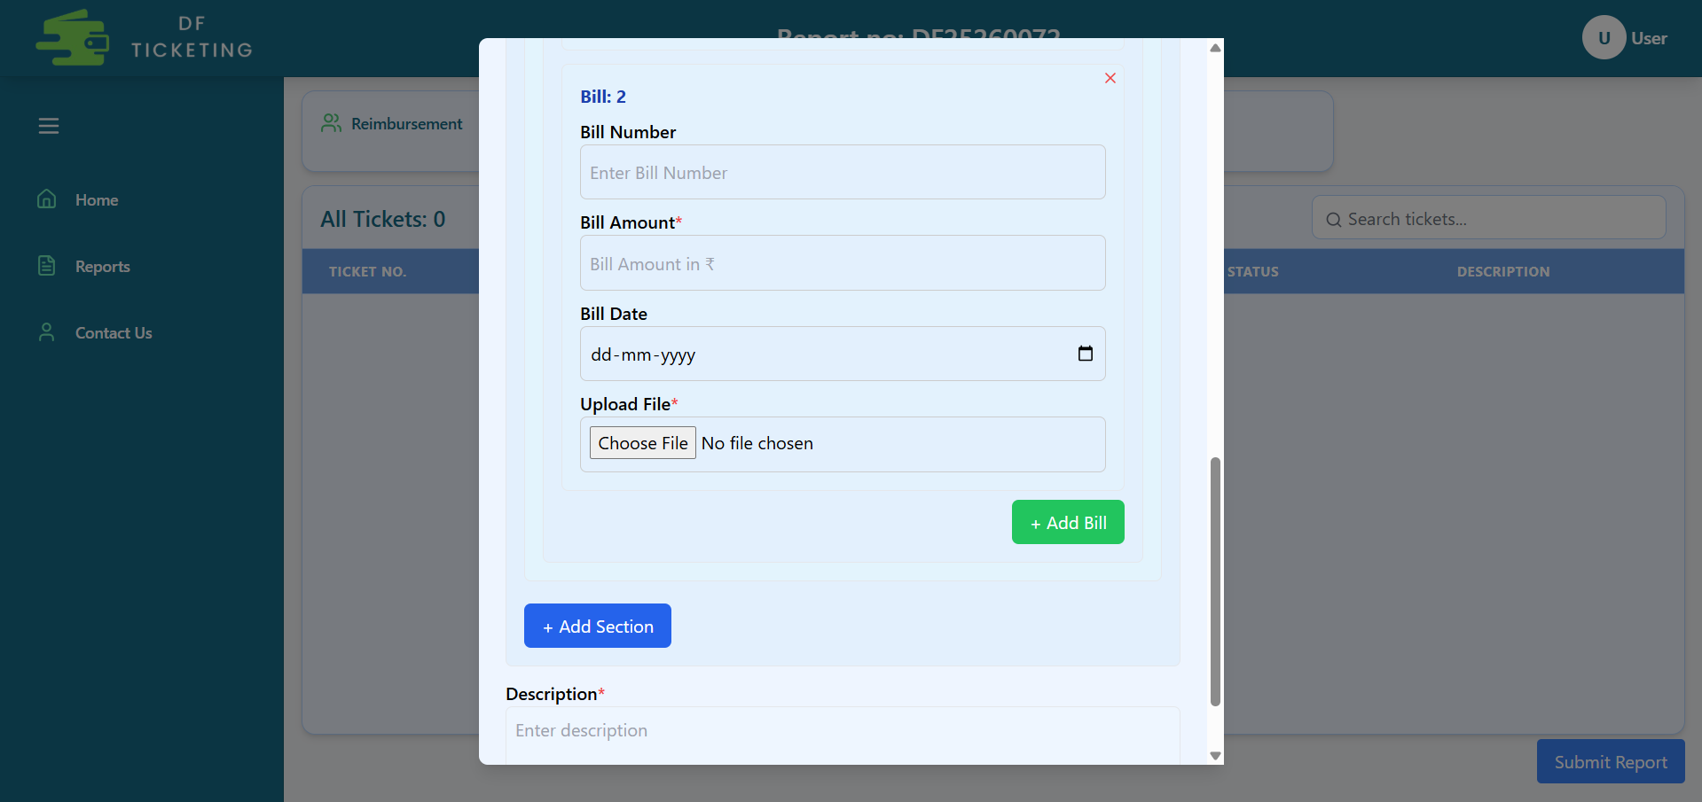
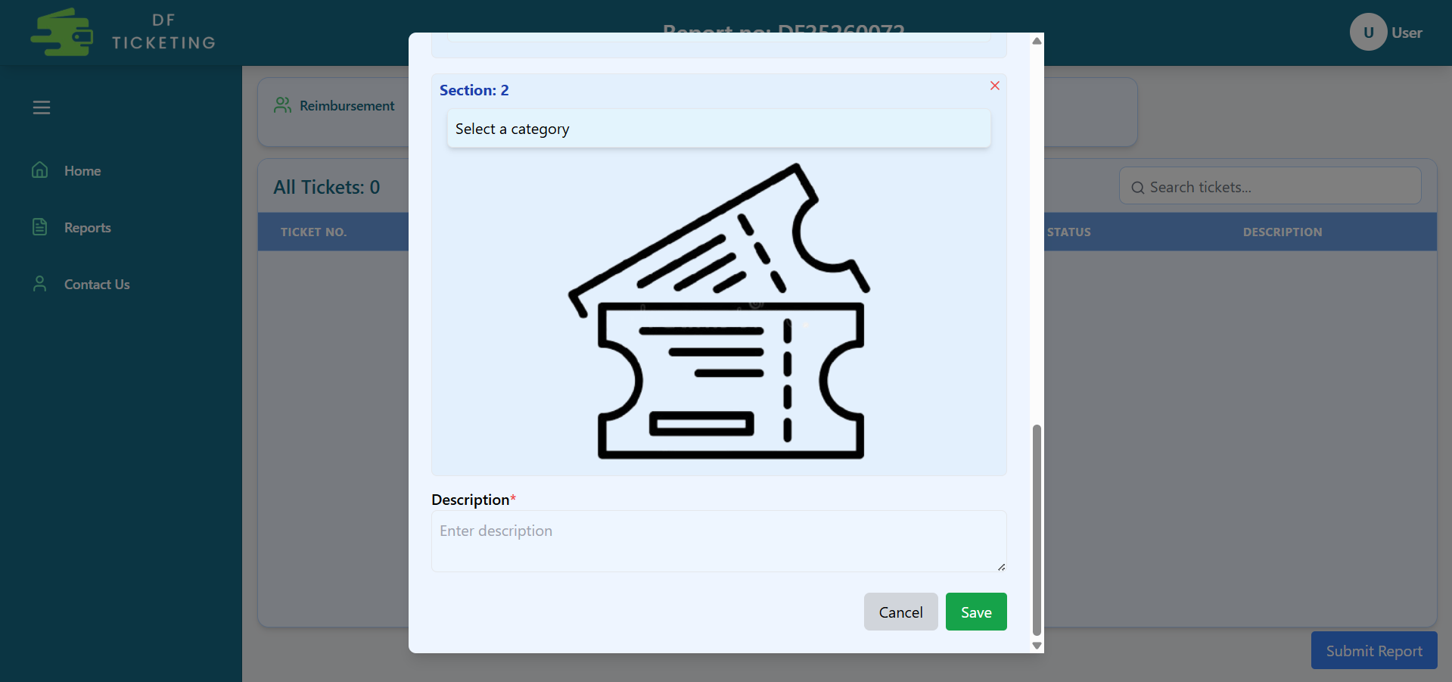
Create Ticket Additional Details
When you click 'Add Bill,' a new bill section will open.
When you select 'Add Section,' a new section opens for you to add a new expense category.
Here, you need to add a brief description.
Click the 'Save' button to create the ticket.

Slide 13
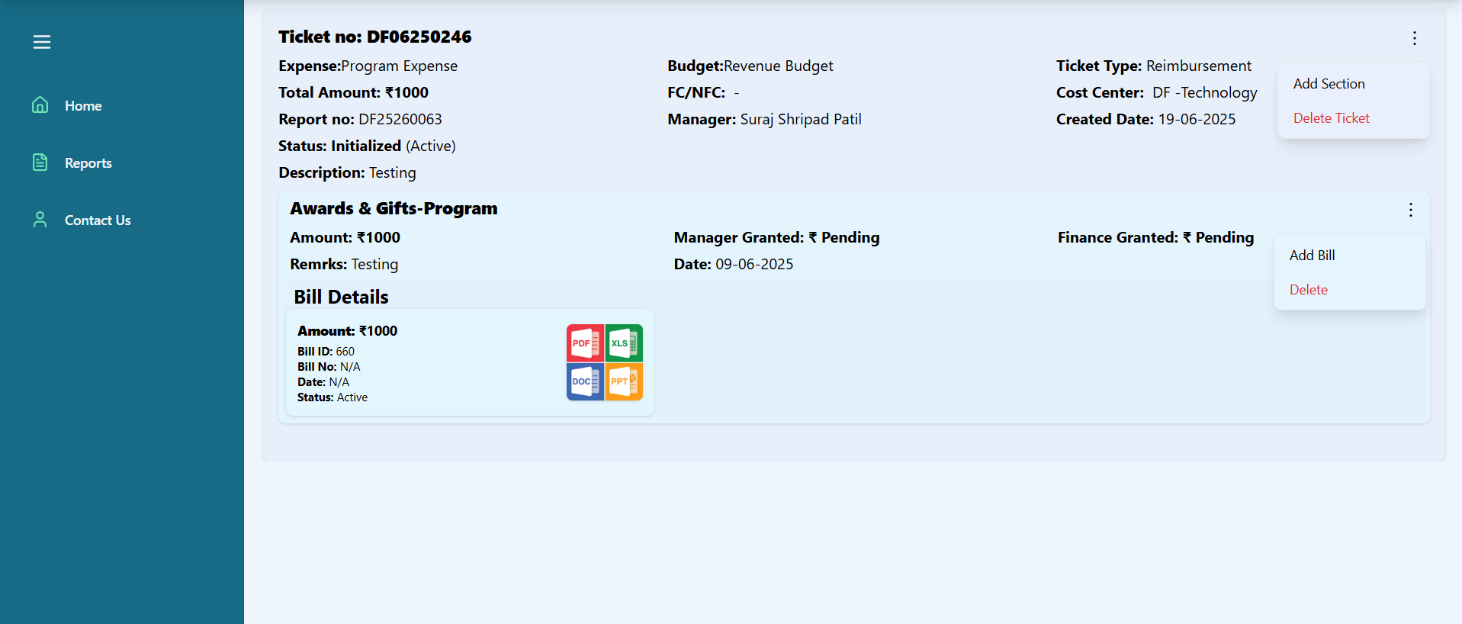
Inside Tickets (Initialized)
At the initial stage i.e., if you have not submitted the report, or if the manager or finance has rejected the ticket you can add a new section to the ticket or delete the entire ticket.
At the initial stage, you can add bills to a section, delete a bill from a section, and also delete the entire section.

Slide 14
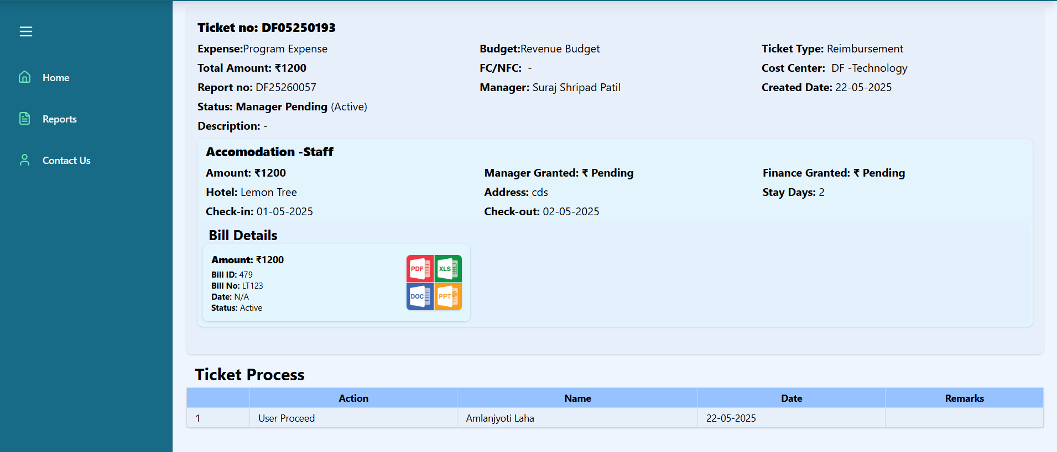
Inside Tickets (After Submission)
Once the report is in 'In Progress' status, you can open the ticket and view the process flow.

Slide 15
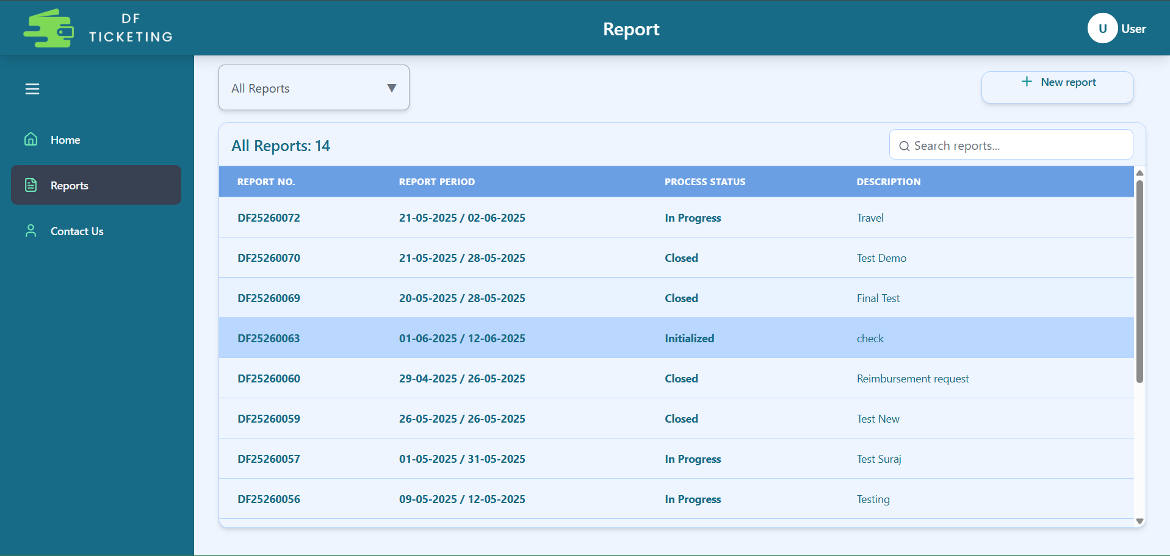
Reports Page

Slide 16
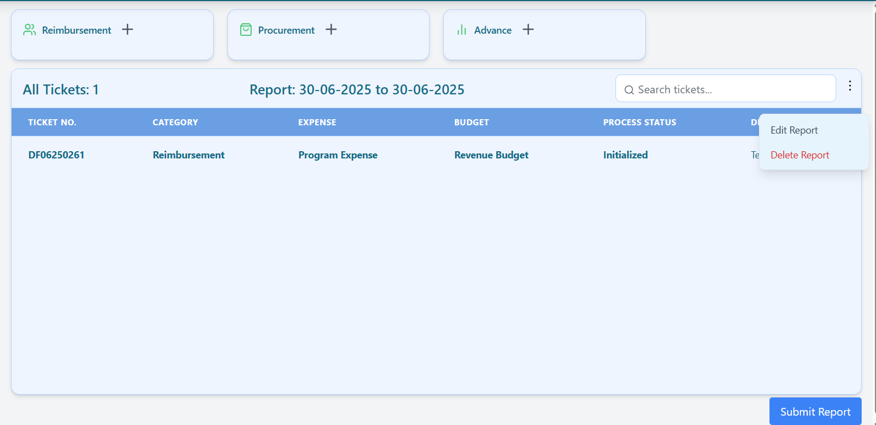
Report Edit
When a report is in the Initialized, Manager Rejected , FA Rejected stage then you can Edit the report.

Slide 17
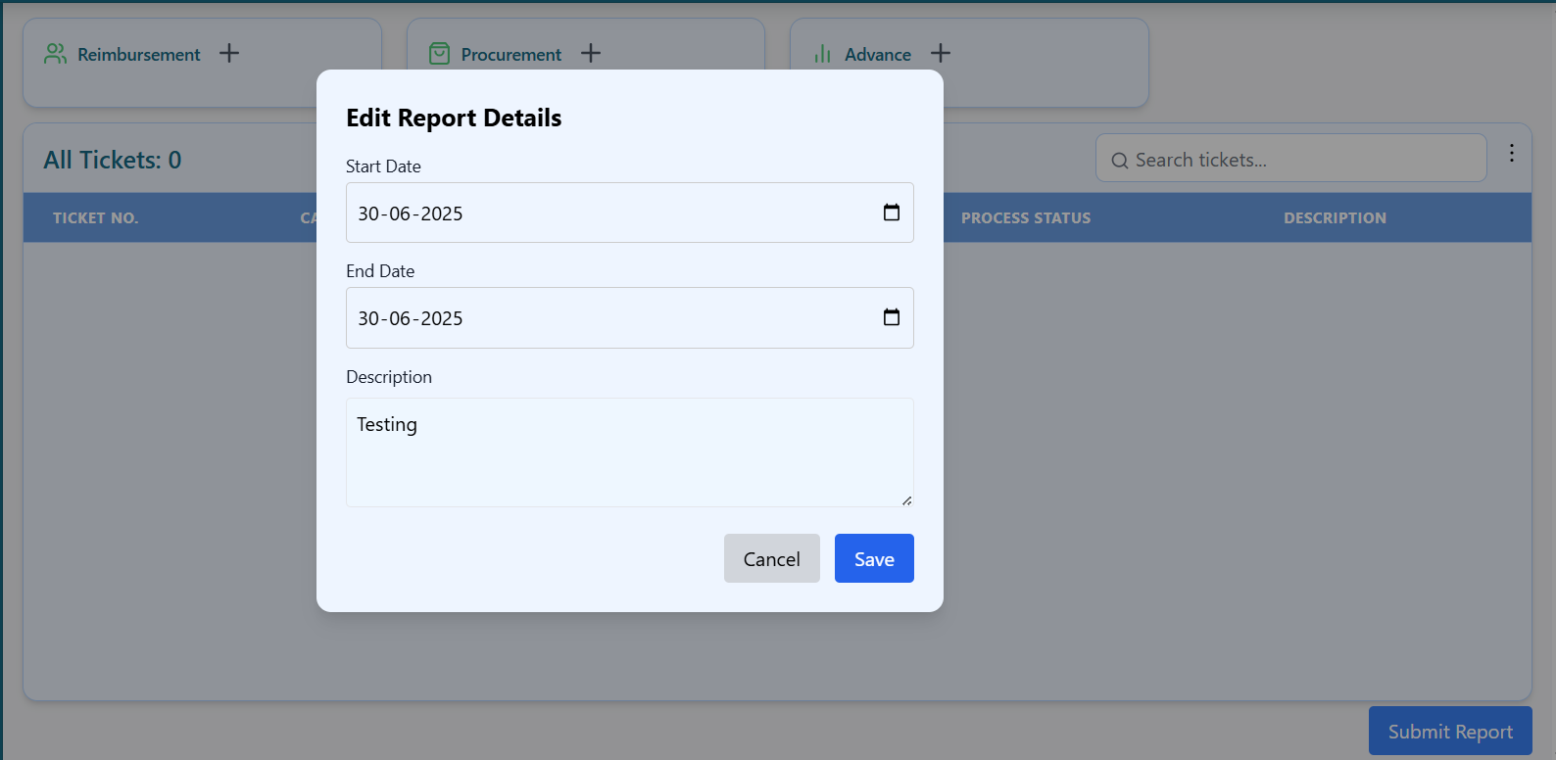
Report Edit Details
In the Report Edit section, you can update the Start Date and End Date (which must be either the current date or a future date), as well as modify the Description of the report.

Slide 18
Report Delete
When a report is in the Initialized, Manager Rejected , FA Rejected stage and all tickets in the report are deleted then you can Delete the entire report.

Slide 19
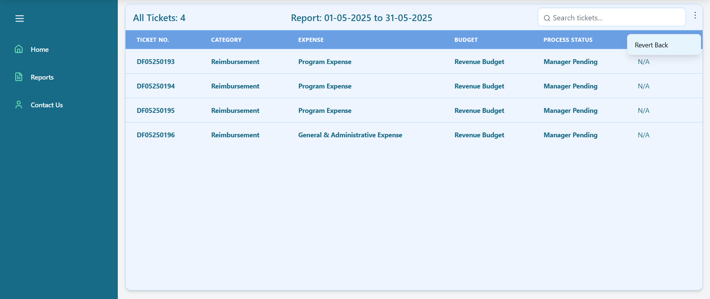
Report Revert Back
If any ticket within a report is in the 'Manager Pending' stage, the report can be reverted. Only tickets in the 'Manager Pending' stage will be reverted.

Slide 20
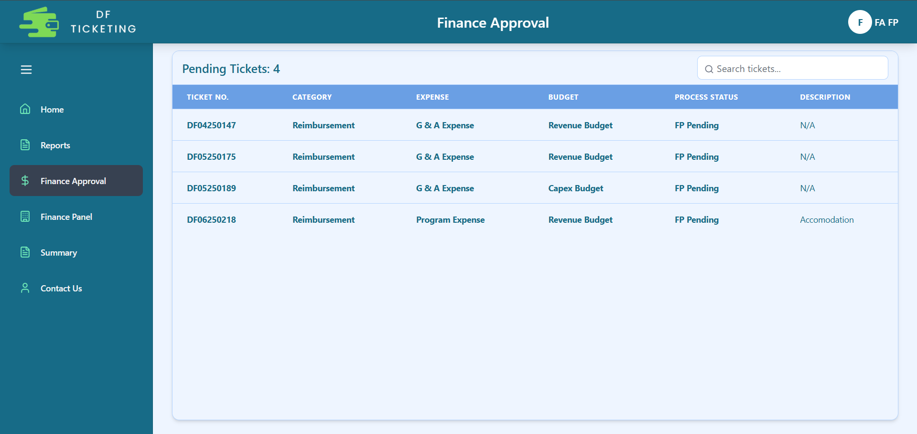
Finance Page
List of tickets pending Finance Approval.
FA and FP can view all tickets in the 'Finance Approval' tab that have been approved by managers and are awaiting Finance Approval.

Slide 21
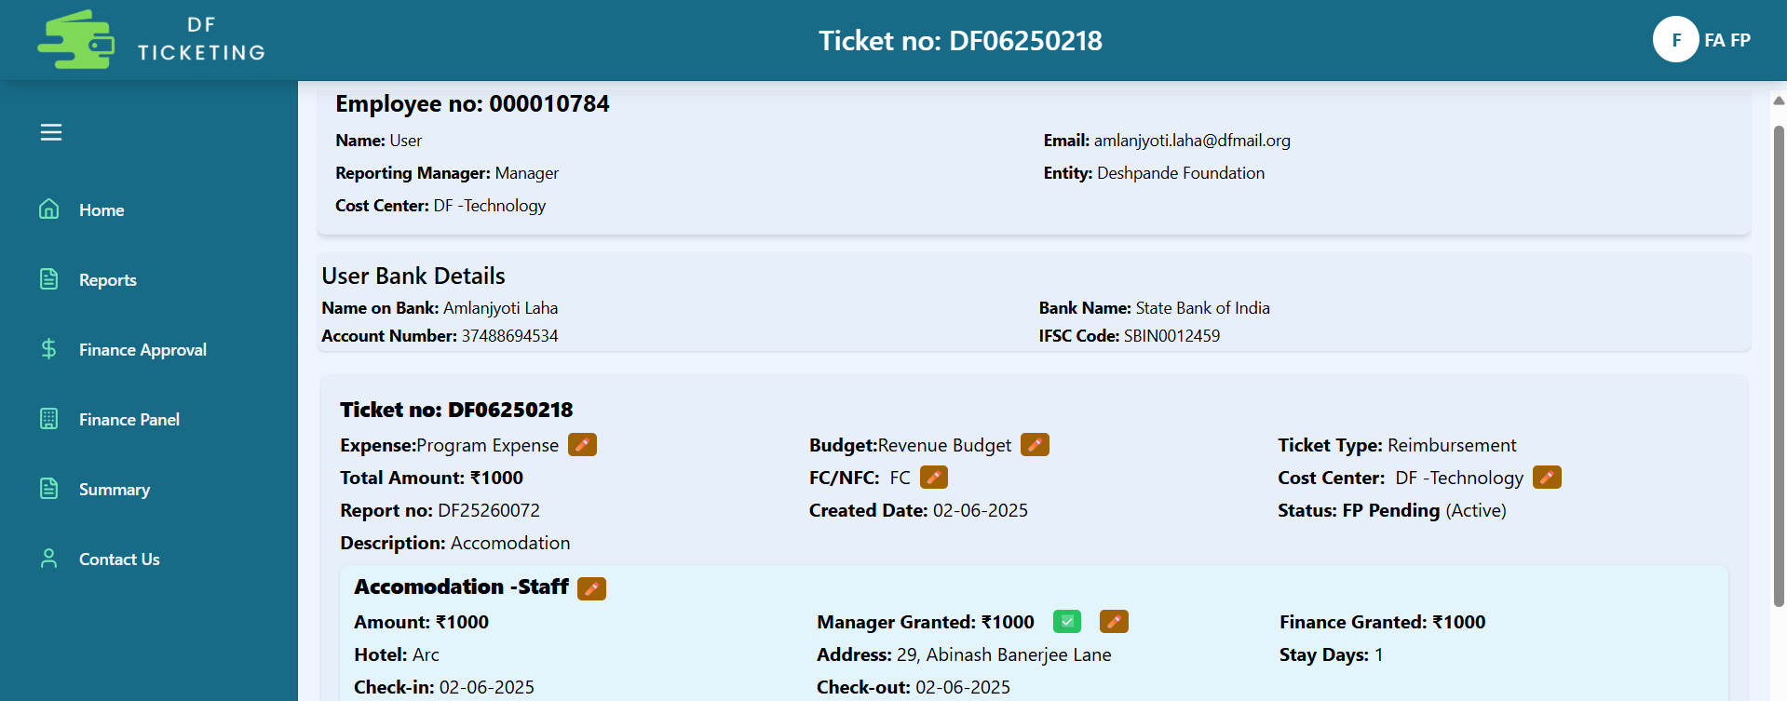
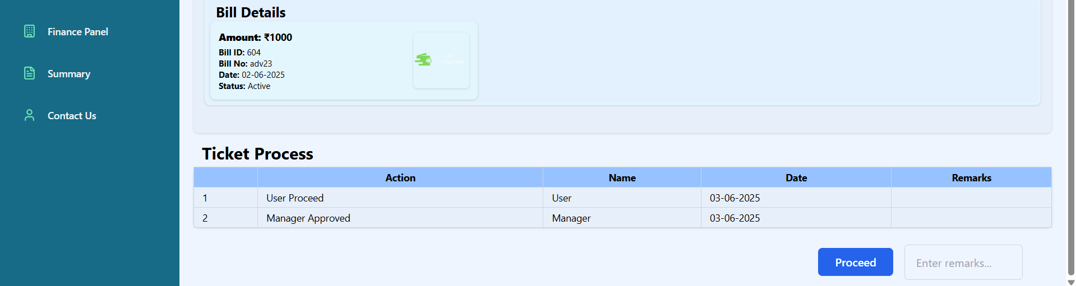
Finance Processer Page
abc.xyz@dfmail.org
User
12345678910
12345678910

Slide 22
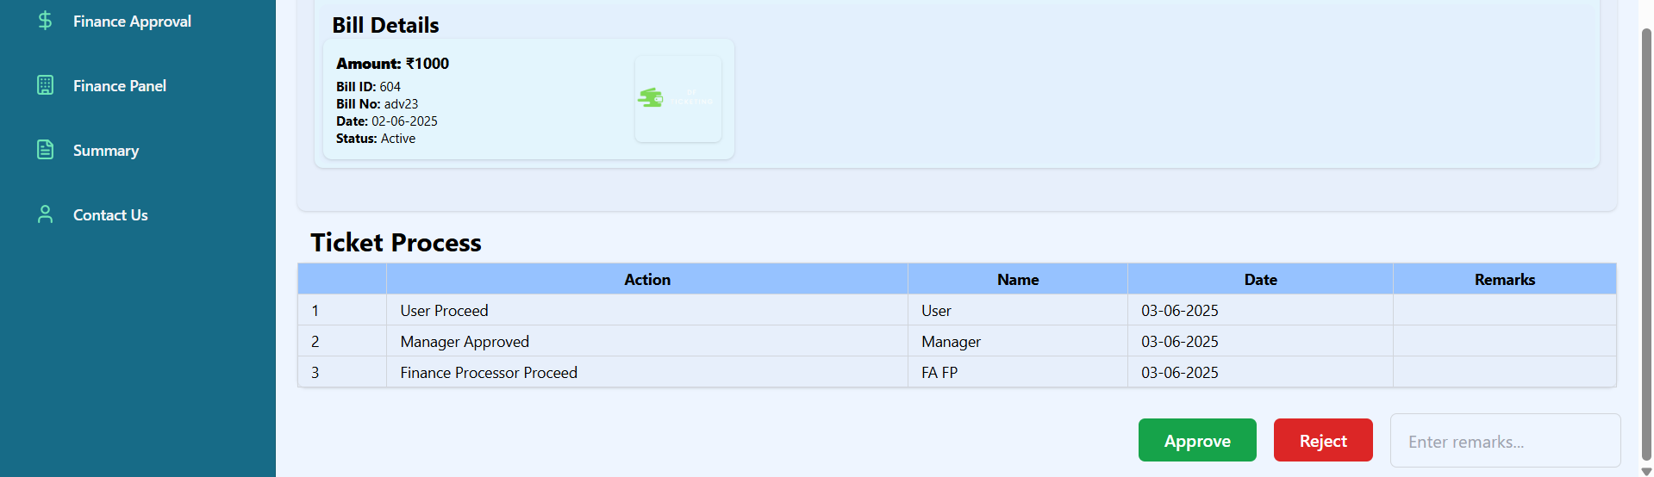
Finance Approver Page
abc.xyz@dfmail.org
User
12345678910
12345678910

Slide 23
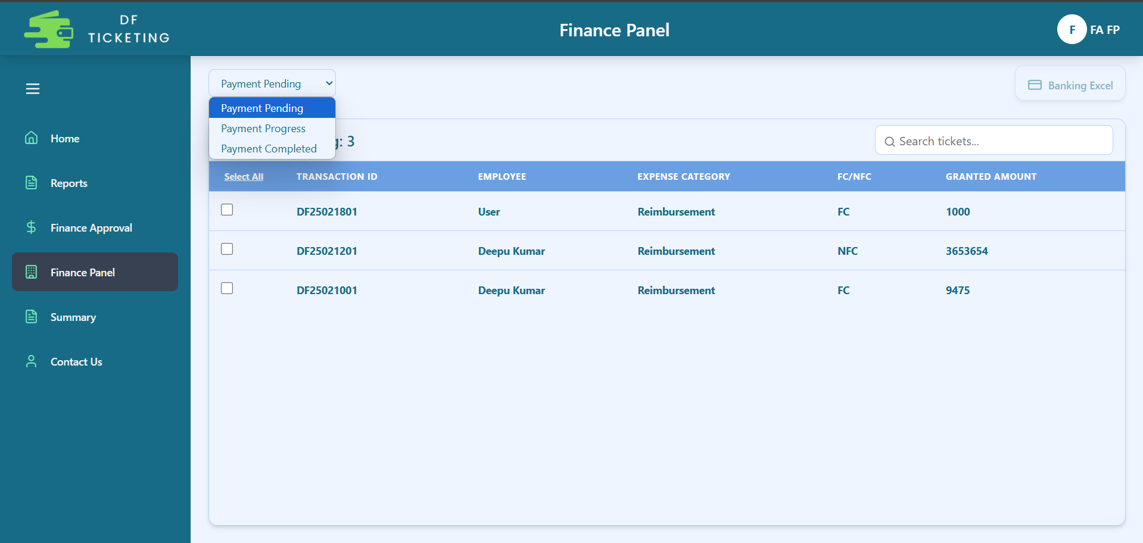
Finance Panel
This page will be accessible to both Finance Approver and Finance Processor.

Slide 24
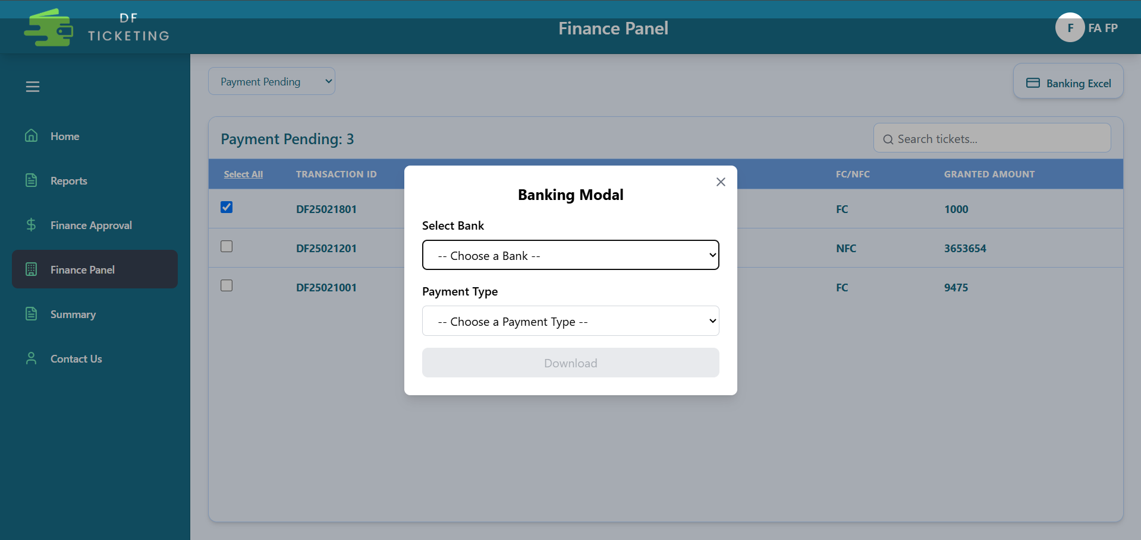
Payment
To process a payment in the Finance Panel, select 'Payment Pending' from the status dropdown at the top left. You will then see a list of tickets pending payment. Select the desired ticket and click the 'Bank Excel' button at the top right. Then, choose the bank and payment type to download the bank Excel file.

Slide 25
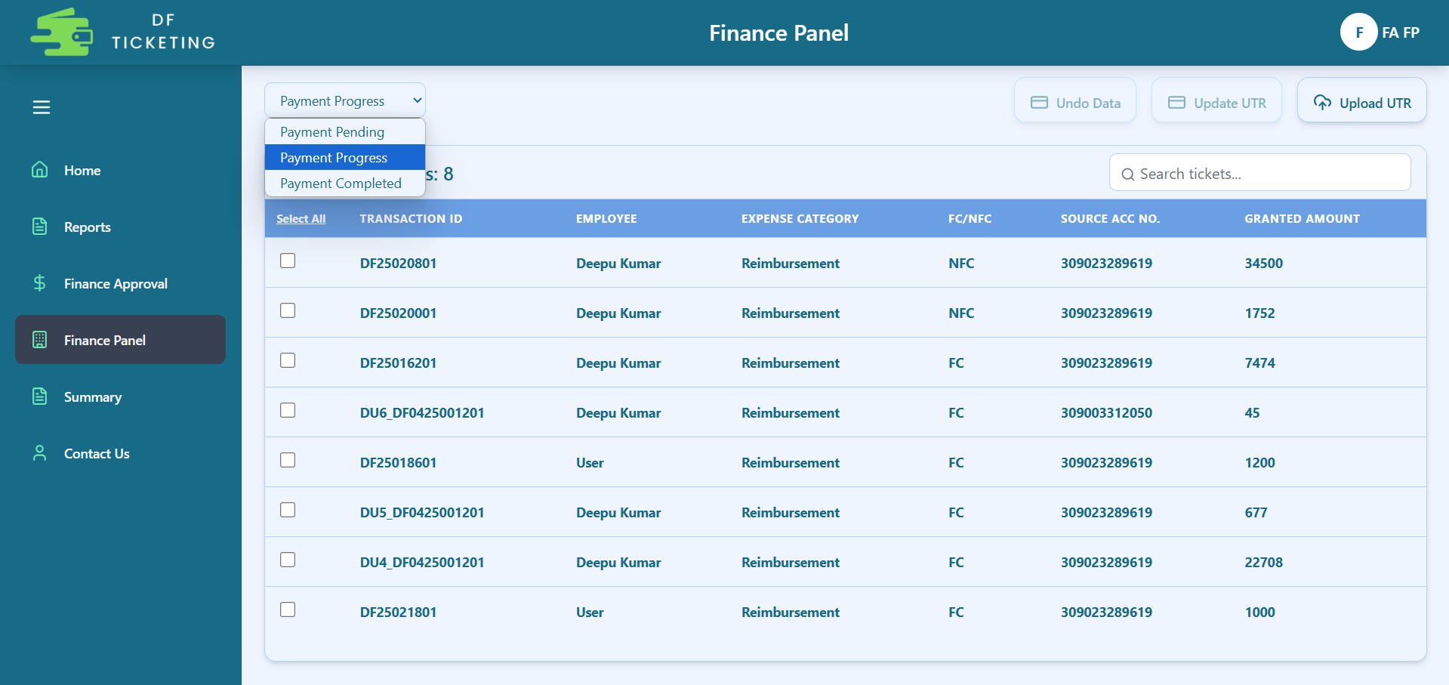
Payment
After that, the ticket will move to the 'Payment in Progress' section. Here, you need to select the ticket for which the payment has been made, then click on 'Update UTR' to download the UTR Excel file. Fill in the required details in the Excel sheet, then click 'Upload UTR' to upload the completed file. Once uploaded, the ticket will be marked as closed, indicating that the payment has been completed.
If you accidentally downloaded the Bank Excel for the wrong ticket, you can select that ticket and click 'Undo Data' to revert it to its previous state.

Slide 26
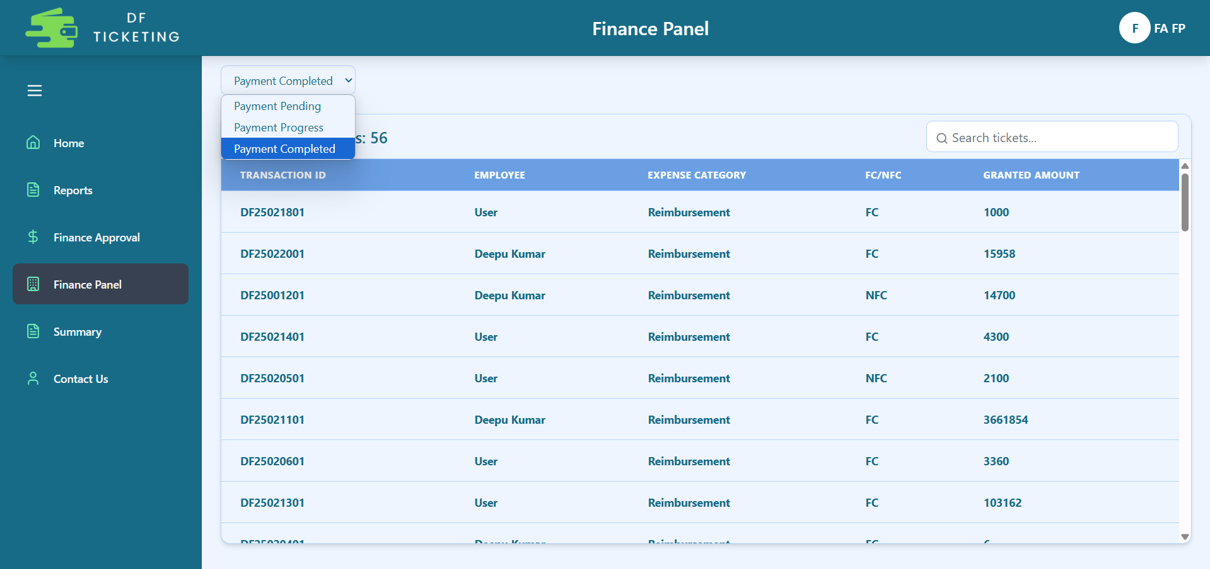
Payment
In this section you will see the list of completed payment tickets.

Slide 27
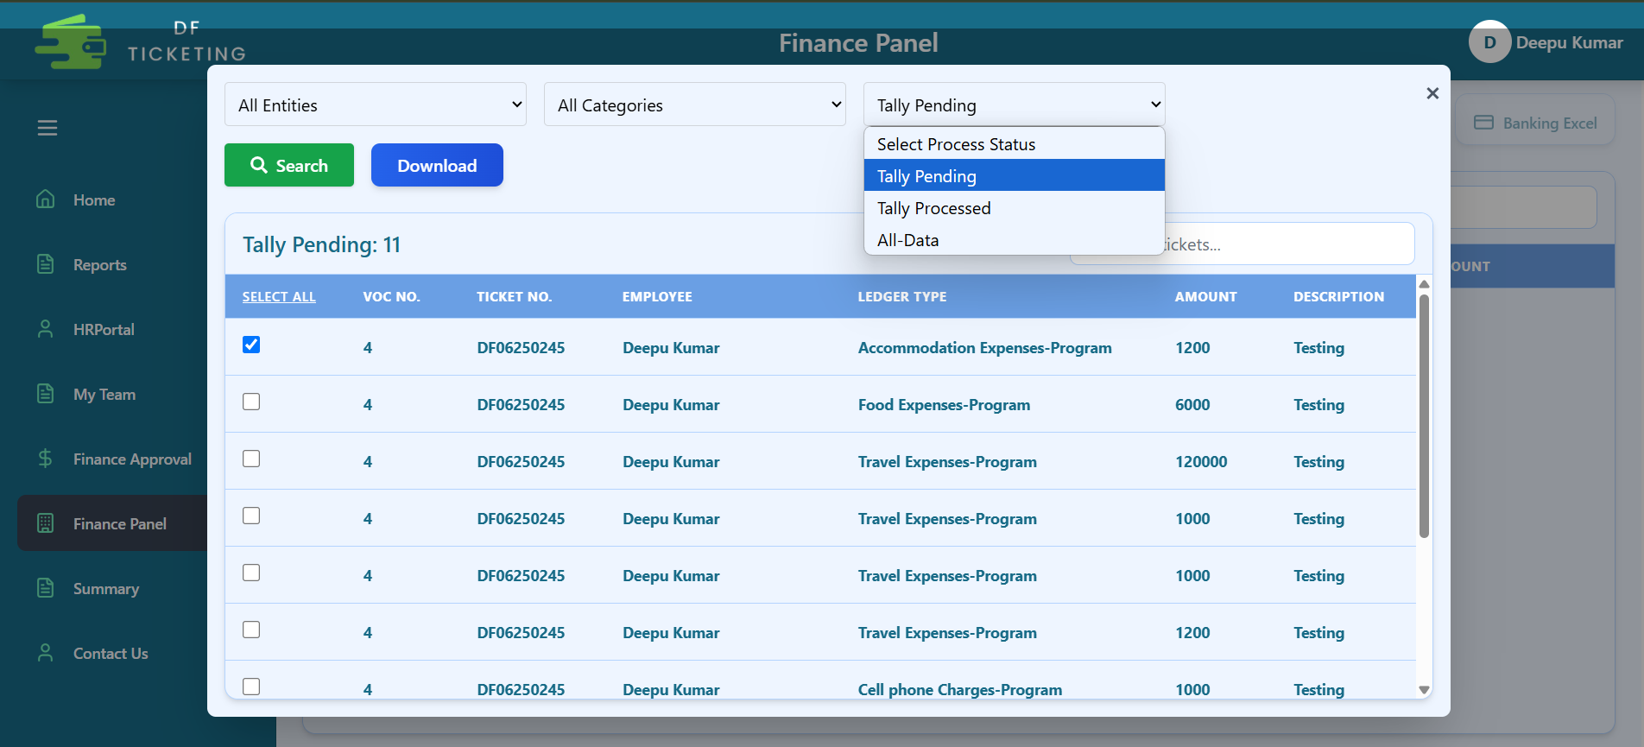
Tally Pending Details
In the Finance panel section, there is a Tally button. Clicking it will open a pop-up where you need to select the entity, expense category, and Tally status.
Once you select a ticket, a Download button will appear, allowing you to download the Tally Excel. The status of that ticket will then change from 'Tally Pending' to 'Tally Processed'.

Slide 28
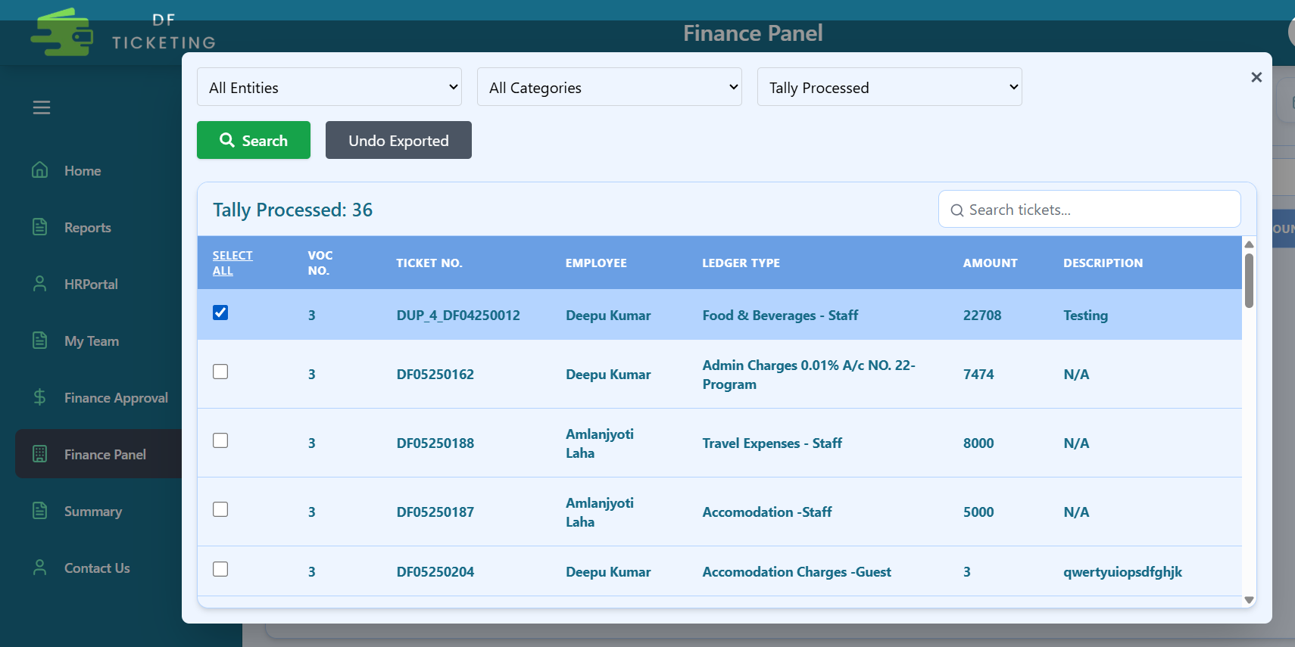
Tally Undo
To view Tally Processed data, you need to select the 'Tally Processed' status.
Once you select a ticket, an Undo button will appear, allowing you to undo the ticket. The status of that ticket will then change from 'Tally Processed' to 'Tally Pending'.

Slide 29
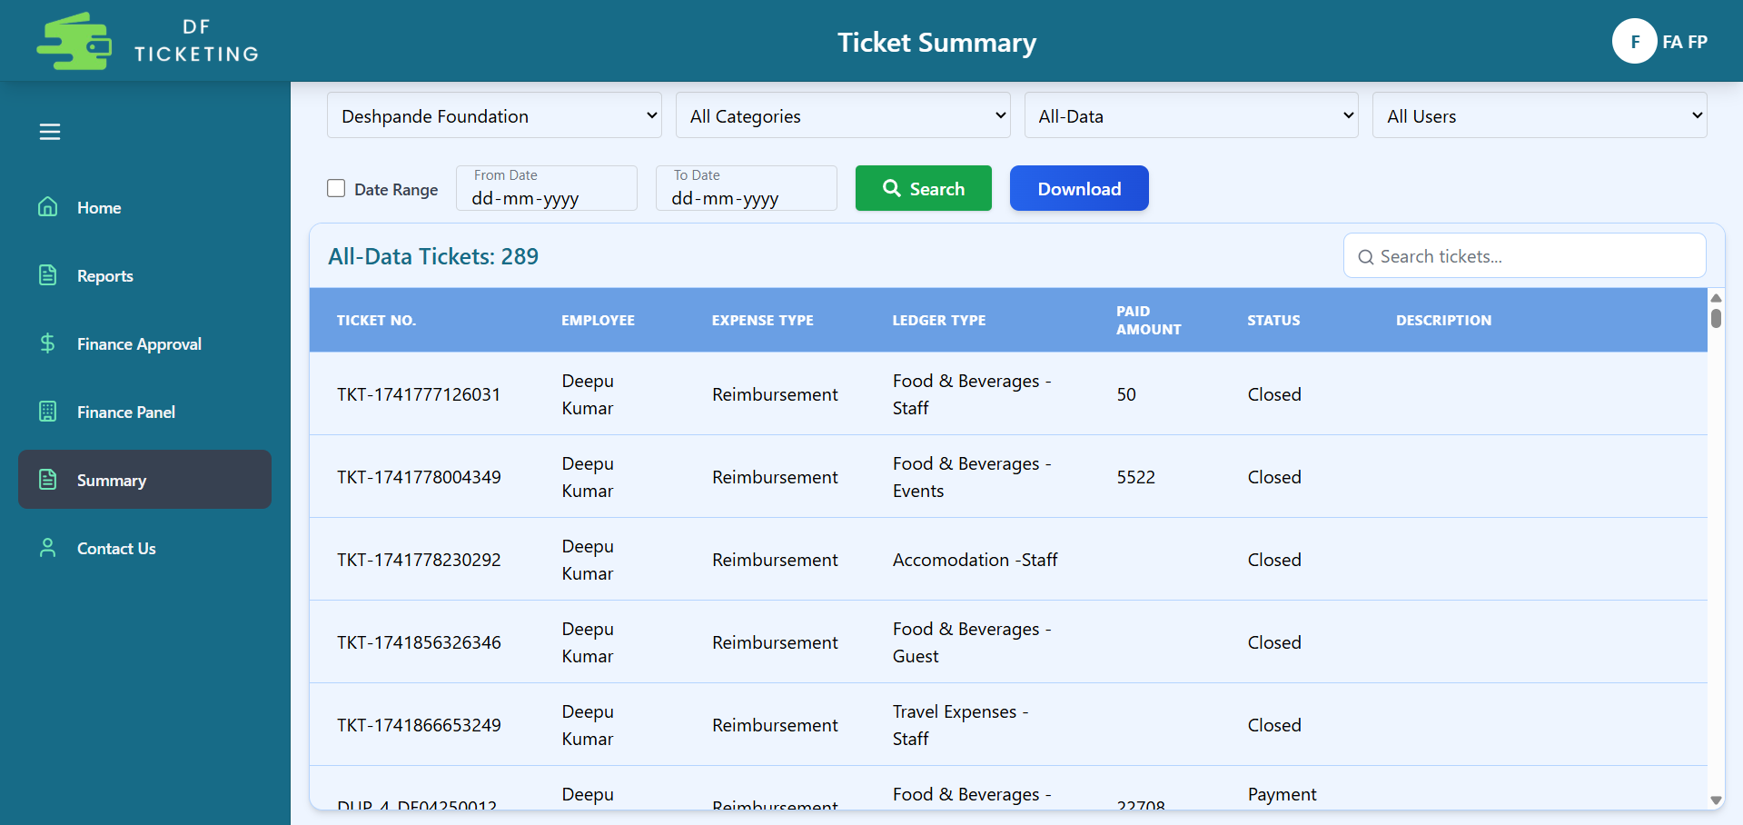
Summary
This section is for the Finance team to retrieve data based on Entity, Expense Type, Process Status, User, and Date Range, which can be downloaded for analysis.

Slide 30
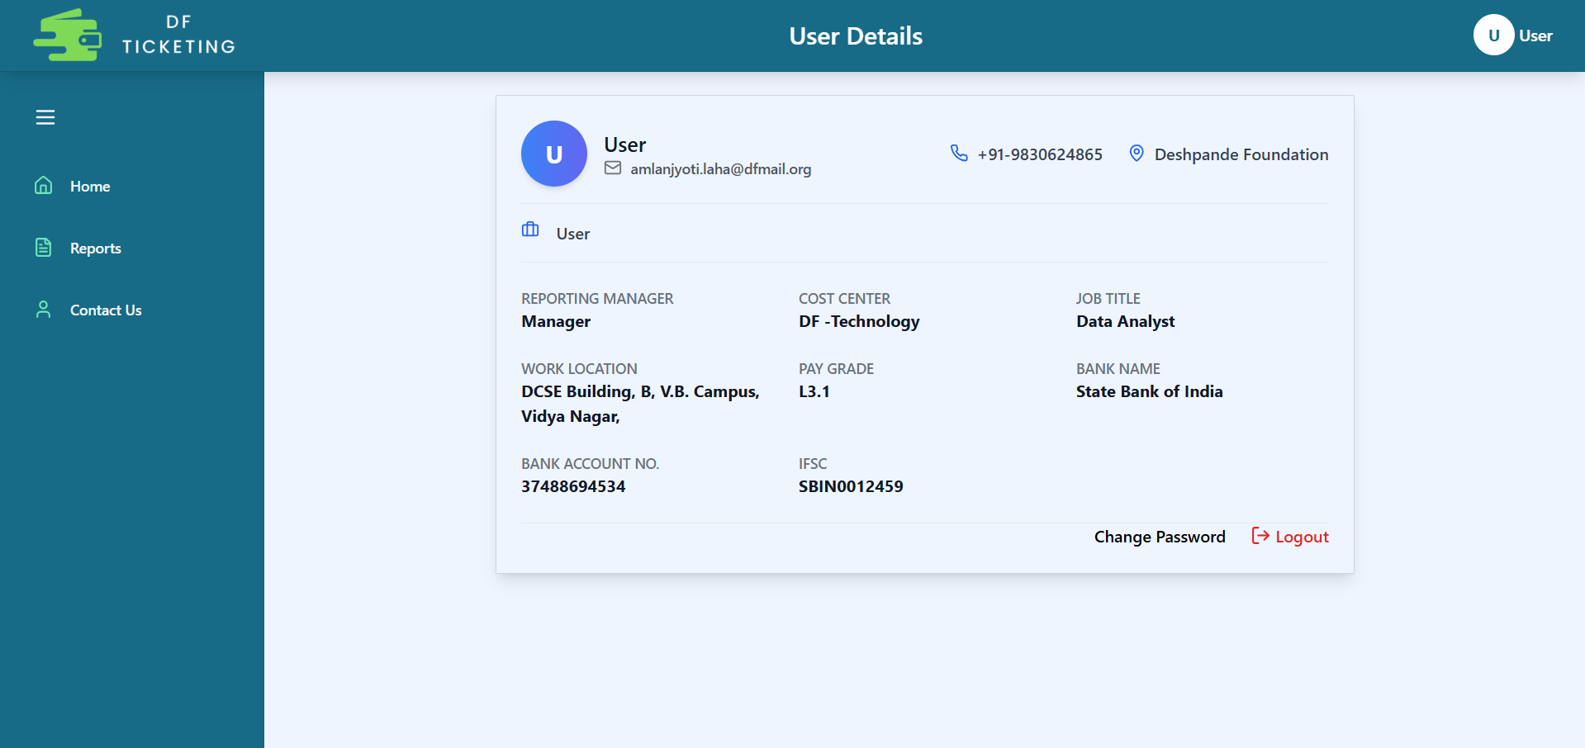
Profile Page
abc.xyz@dfmail.org
999999999
999999999
999999999

Slide 31
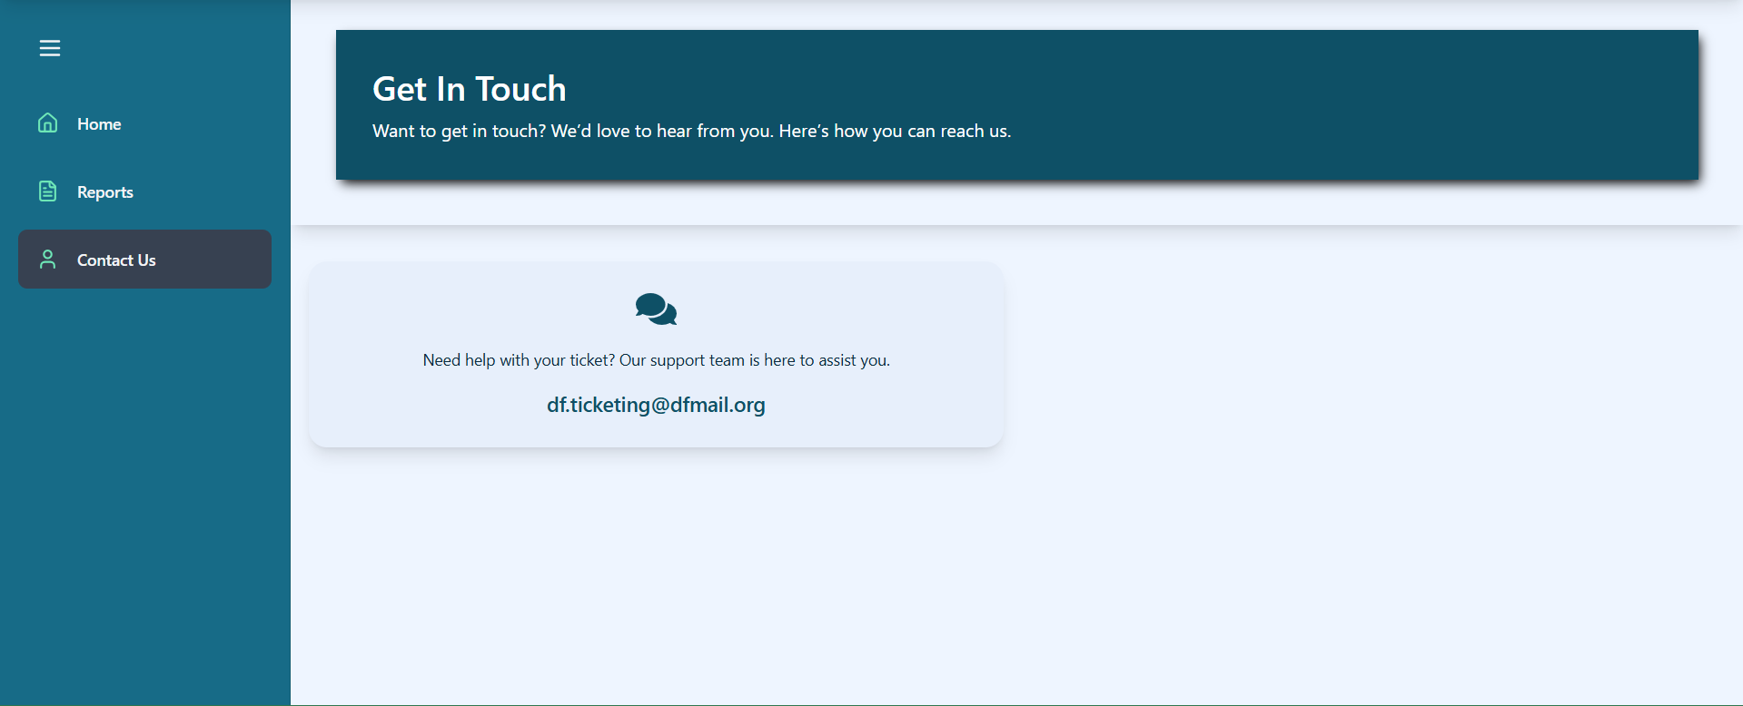
Contact Page

Slide 32
Thank You

